Slide 1

Chapter 2—Programming by Example
Java
The Art and Science of
An Introduction
C H A P T E R 2
ERIC S. ROBERTS
to Computer Science
Programming by Example
Example is always more efficacious than precept.
—Samuel Johnson, Rasselas, 1759
CS101 @ Özyeğin University
Slides are adapted from the originals available at
http://www-cs-faculty.stanford.edu/~eroberts/books/ArtAndScienceOfJava/

Slide 2
The “Hello World” Program in Java
The text to be printed is indicated by supplying an argument to println. Here, the argument is the string “hello, world”.
The simple “Hello World” example illustrates several features that are common to the programs you will see in this book.
This first few lines (everything between /* and */) are an example of a comment, which is intended for human readers.
The next two lines are the imports, which indicate what library packages the program uses.
The last few lines in the file define the HelloProgram class, which the extends keyword identifies as a GraphicsProgram.
A class definition in Java typically contains a series of entries. This example has one entry, which is a method called run.
A Java method consists of a series of statements. Here, the only statement is a call to println, which prints a line.
/*
* File: HelloWorld.java
* -----------------------
* This program displays "hello, world" on the screen.
* It is inspired by the first program in Brian
* Kernighan and Dennis Ritchie's classic book,
* The C Programming Language.
*/
import acm.program.*;
public class HelloWorld extends ConsoleProgram {
public void run() {
println( "hello, world");
}
}
/*
* File: HelloWorld.java
* -----------------------
* This program displays "hello, world" on the screen.
* It is inspired by the first program in Brian
* Kernighan and Dennis Ritchie's classic book,
* The C Programming Language.
*/
import acm.program.*;
public class HelloWorld extends ConsoleProgram {
public void run() {
println( "hello, world");
}
}

Slide 3
Graphical “Hello World” Program
The simple “Hello World” example illustrates several features that are common to the programs you will see in this book.
This first few lines (everything between /* and */) are an example of a comment, which is intended for human readers.
The next two lines are the imports, which indicate what library packages the program uses.
The last few lines in the file define the HelloProgram class, which the extends keyword identifies as a GraphicsProgram.
A class definition in Java typically contains a series of entries. This example has one entry, which is a method called run.
A Java method consists of a series of statements. Here, the only statement is a call to add, which adds an object to the display.
The object to be added is indicated by supplying an argument to the add method. Here, the argument is a new GLabel object.
In Java, objects are created by using a constructor, which consists of the keyword new followed by the class name and arguments.
The arguments supply information that the constructor needs to make the object, such as the string to display and the coordinates.
The next slide simulates the operation of HelloProgram so that you can get a sense of what appears on the display.
/*
* File: HelloProgram.java
* -----------------------
* This program displays "hello, world" on the screen.
* It is inspired by the first program in Brian
* Kernighan and Dennis Ritchie's classic book,
* The C Programming Language.
*/
import acm.graphics.*;
import acm.program.*;
public class HelloProgram extends GraphicsProgram {
public void run() {
add( new GLabel( "hello, world", 100, 75 ) );
}
}
/*
* File: HelloProgram.java
* -----------------------
* This program displays "hello, world" on the screen.
* It is inspired by the first program in Brian
* Kernighan and Dennis Ritchie's classic book,
* The C Programming Language.
*/
import acm.graphics.*;
import acm.program.*;
public class HelloProgram extends GraphicsProgram {
public void run() {
add( new GLabel( "hello, world", 100, 75 ) );
}
}
/*
* File: HelloProgram.java
* -----------------------
* This program displays "hello, world" on the screen.
* It is inspired by the first program in Brian
* Kernighan and Dennis Ritchie's classic book,
* The C Programming Language.
*/
import acm.graphics.*;
import acm.program.*;
public class HelloProgram extends GraphicsProgram {
public void run() {
add( new GLabel( "hello, world", 100, 75 ) );
}
}

Slide 4
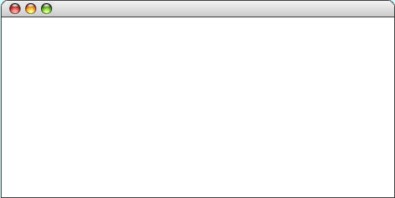
The “Hello World” Program in Java
import acm.graphics.*;
import acm.program.*;
public class HelloProgram extends GraphicsProgram {
public void run() {
add( new GLabel("hello, world", 100, 75) );
}
}
import acm.graphics.*;
import acm.program.*;
public class HelloProgram extends GraphicsProgram {
public void run() {
add( new GLabel("hello, world", 100, 75) );
}
}
HelloProgram
hello, world

Slide 5
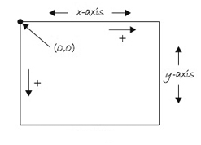
The Java Coordinate System
Positions and distances in a graphics program are measured in terms of pixels, which are the individual dots that cover the screen.
Unlike traditional mathematics, Java defines the origin of the coordinate system to be in the upper left corner. Values for the x coordinate increase as you move rightward across the screen; y coordinate values increase as you move downward.

Slide 6

Exercise:
Graphical Output
Draw the output of the following program (approximately)
import acm.graphics.*;
import acm.program.*;
public class HelloProgram extends GraphicsProgram {
public void run() {
add( new GLabel("hello, world", 100, 75) );
add( new GLabel("hello, world", 125, 150) );
add( new GLabel("hello, world", 150, 225) );
}
}

Slide 7
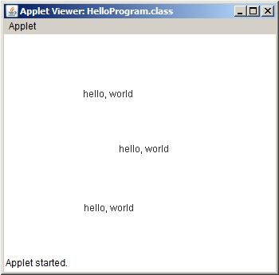
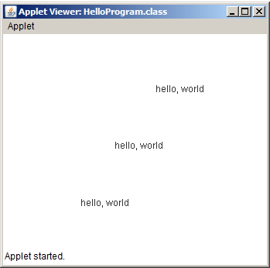
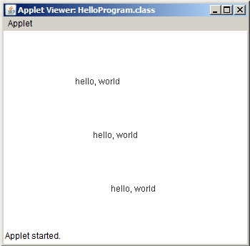
Guess the output
import acm.graphics.*;
import acm.program.*;
public class HelloProgram extends GraphicsProgram {
public void run() {
add( new GLabel("hello, world", 100, 75) );
add( new GLabel("hello, world", 125, 150) );
add( new GLabel("hello, world", 150, 225) );
}
}
A
B
C

Slide 8
Guess the output
import acm.graphics.*;
import acm.program.*;
public class HelloProgram extends GraphicsProgram {
public void run() {
add( new GLabel("hello, world", 100, 75) );
add( new GLabel("hello, world", 125, 150) );
add( new GLabel("hello, world", 150, 225) );
}
}
A
B
C

Slide 9
A Program to Add Two Numbers
import acm.program.*;
public class Add2Integers extends ConsoleProgram {
public void run() {
println("This program adds two numbers.");
int n1 = readInt("Enter n1: ");
int n2 = readInt("Enter n2: ");
int total = n1 + n2;
println("The total is " + total + ".");
}
}
import acm.program.*;
public class Add2Integers extends ConsoleProgram {
public void run() {
println("This program adds two numbers.");
int n1 = readInt("Enter n1: ");
int n2 = readInt("Enter n2: ");
int total = n1 + n2;
println("The total is " + total + ".");
}
}

Slide 10
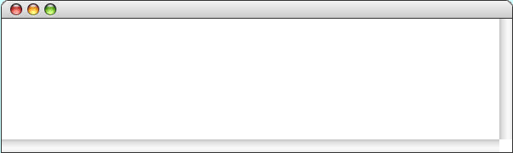
The Add2Integers Program
class Add2Integers extends ConsoleProgram {
public void run() {
println("This program adds two numbers.");
int n1 = readInt("Enter n1: ");
int n2 = readInt("Enter n2: ");
int total = n1 + n2;
println("The total is " + total + ".");
}
}
class Add2Integers extends ConsoleProgram {
public void run() {
println("This program adds two numbers.");
int n1 = readInt("Enter n1: ");
int n2 = readInt("Enter n2: ");
int total = n1 + n2;
println("The total is " + total + ".");
}
}
n1
n2
total
n1
n2
total
17
17
25
25
42
42
Add2Integers
This program adds two numbers.
Enter n1:
17
Enter n2:
25
The total is 42.

Slide 11
Programming Idioms and Patterns
Experienced programmers can recognize a variety of common operations and have learned a standard solution strategy for each one. The code that implements such a solution strategy is called a programming idiom or programming pattern. Learning to use these patterns saves you from having to think about the nitty-gritty details.
As an example, it is important to think of a statement like
int n1 = readInt("Enter n1: ");
not in terms of what each part of the statement means, but rather as a holistic pattern to read an integer from the user:
int variable = readInt("prompt");

Slide 12
Exercise:
Adding Three Integers
Try to modify the program below so that it adds up 3 Integers
class Add2Integers extends ConsoleProgram {
public void run() {
println("This program adds two numbers.");
int n1 = readInt("Enter n1: ");
int n2 = readInt("Enter n2: ");
int total = n1 + n2;
println("The total is " + total + ".");
}
}

Slide 13
println("This program adds three numbers.");
int n1 = readInt("Enter n1: ");
int n2 = readInt("Enter n2: ");
int n3 = readInt("Enter n2: ");
int total = n1 + n2;
println("The total is " + total + ".");
A
println("This program adds two numbers.");
int n1 = readInt("Enter n1: ");
int n2 = readInt("Enter n2: ");
int n3 = readInt("Enter n2: ");
int total = n1 + n2 + n3;
println("The total is " + total + ".");
B
println("This program adds three numbers.");
int n1 = readInt("Enter n1: ");
int n2 = readInt("Enter n2: ");
int n2 = readInt("Enter n3: ");
int total = n1 + n2 + n3;
println("The total is " + total + ".");
C

Slide 14
println("This program adds three numbers.");
int n1 = readInt("Enter n1: ");
int n2 = readInt("Enter n2: ");
int n3 = readInt("Enter n2: ");
int total = n1 + n2;
println("The total is " + total + ".");
A
println("This program adds two numbers.");
int n1 = readInt("Enter n1: ");
int n2 = readInt("Enter n2: ");
int n3 = readInt("Enter n2: ");
int total = n1 + n2 + n3;
println("The total is " + total + ".");
B
println("This program adds three numbers.");
int n1 = readInt("Enter n1: ");
int n2 = readInt("Enter n2: ");
int n2 = readInt("Enter n3: ");
int total = n1 + n2 + n3;
println("The total is " + total + ".");
C

Slide 15
The Add3Integers Program
class Add3Integers extends ConsoleProgram {
public void run() {
println("This program adds three numbers.");
int n1 = readInt("Enter n1: ");
int n2 = readInt("Enter n2: ");
int n3 = readInt("Enter n3: ");
int total = n1 + n2 + n3;
println("The total is " + total + ".");
}
}
class Add2Integers extends ConsoleProgram {
public void run() {
println("This program adds two numbers.");
int n1 = readInt("Enter n1: ");
int n2 = readInt("Enter n2: ");
int total = n1 + n2;
println("The total is " + total + ".");
}
}
n1
n2
total
17
25
42

Slide 16
The Add2Doubles Program
class Add2Doubles extends ConsoleProgram {
public void run() {
println("This program adds real numbers.");
double n1 = readDouble("Enter n1: ");
double n2 = readDouble("Enter n2: ");
double total = n1 + n2;
println("The total is " + total + ".");
}
}
class Add2Integers extends ConsoleProgram {
public void run() {
println("This program adds two numbers.");
int n1 = readInt("Enter n1: ");
int n2 = readInt("Enter n2: ");
int total = n1 + n2;
println("The total is " + total + ".");
}
}
n1
n2
total
17
25
42
double is the double-precision real number type.

Slide 17
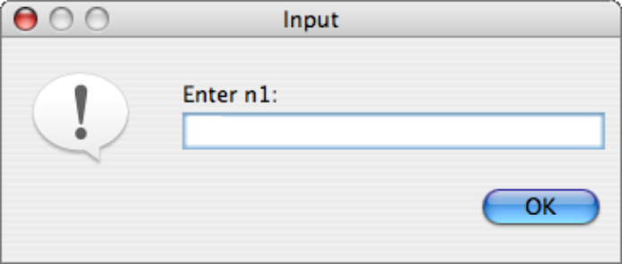
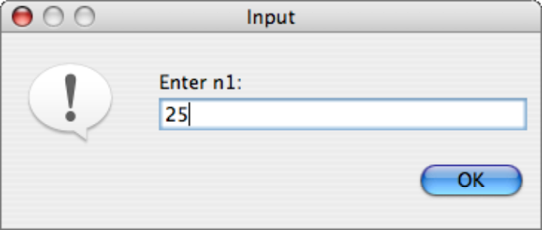
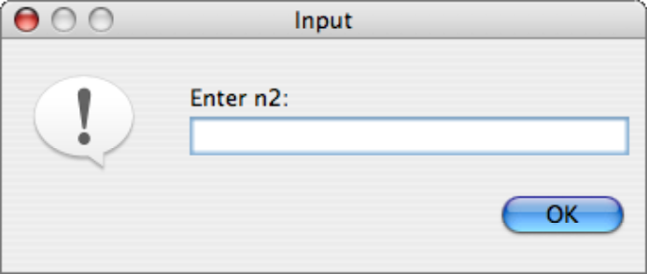
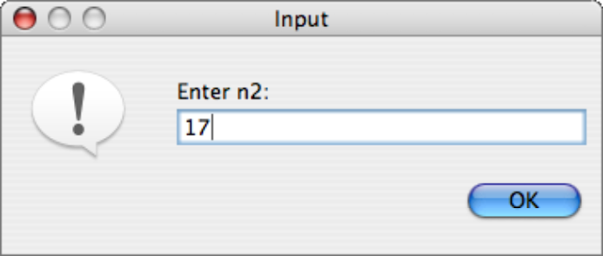
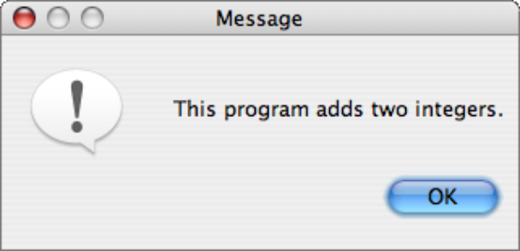
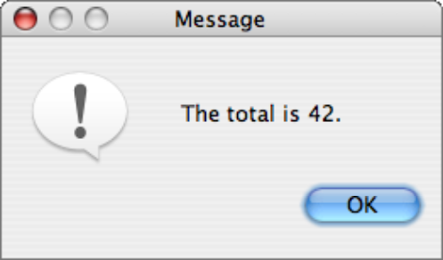
The DialogProgram Class
In object-oriented languages like Java, a class definition specifies the behavior of objects of that class. The DialogProgram class has exactly the same operations as the ConsoleProgram class; the only difference is that the input and output operations use popup dialogs instead of a console, as illustrated by the following implementation of AddTwoIntegers:
public class Add2Integers extends DialogProgram {
public void run() {
println("This program adds two numbers.");
int n1 = readInt("Enter n1: ");
int n2 = readInt("Enter n2: ");
int total = n1 + n2;
println("The total is " + total + ".");
}
}
public class Add2Integers extends DialogProgram {
public void run() {
println("This program adds two numbers.");
int n1 = readInt("Enter n1: ");
int n2 = readInt("Enter n2: ");
int total = n1 + n2;
println("The total is " + total + ".");
}
}

Slide 18
Graphical Programs
The GraphicsProgram class makes it possible to create simple pictures on the screen.
Running a GraphicsProgram creates a window that serves as the background canvas. You create pictures by creating graphical objects of various kinds and then adding those objects to the canvas.
e.g., labels, rectangles, ovals, and lines using the classes GLabel, GRect, GOval, and GLine.

Slide 19
Classes and Objects
Java programs are written as collections of classes, which serve as templates for individual objects.
Each object is an instance of a particular class, which can serve as a pattern for many different objects.

Slide 20
Sending Messages to Objects
In many applications, you will need to change the appearance of a graphical object after you have created it. For example, you might want to have the object change its color or move to a new position on the canvas.
In object-oriented languages like Java, such changes are the responsibility of the object. To change the color of an object you send a message to the object asking it to change color.
Java uses the following syntax to send a message to an object:
receiver.name(arguments);
where receiver is the object to which the message is directed, name identifies the type of message, and arguments is a list of values used to specify any other information associated with the message.

Slide 21
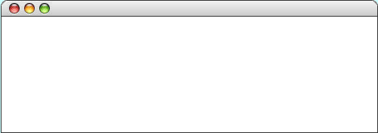
Sending Messages to a GLabel
The following program illustrates sending a message to an object. Note that the label doesn’t appear until it is added to the canvas.
public class HelloProgram extends GraphicsProgram {
public void run() {
GLabel label = new GLabel("hello, world", 100, 75);
label.setFont("SansSerif-36");
label.setColor(Color.RED);
add(label);
}
}
public class HelloProgram extends GraphicsProgram {
public void run() {
GLabel label = new GLabel("hello, world", 100, 75);
label.setFont("SansSerif-36");
label.setColor(Color.RED);
add(label);
}
}
label
label
hello, world
hello, world
hello, world
hello, world
HelloProgram
hello, world
skip simulation

Slide 22
The GObject Hierarchy
The classes that represent graphical objects form a hierarchy, part of which looks like this:
GObject
GLabel
GRect
GOval
GLine
The GObject class represents the collection of all graphical objects. The four subclasses shown in this diagram correspond to particular types of objects: labels, rectangles, ovals, and lines. The class diagram makes it clear that any GLabel, GRect, GOval, or GLine is also a GObject.
Operations on graphical objects are defined at each level of the hierarchy. Operations that apply to all graphical objects are specified at the GObject level, where they are inherited by each subclass. Operations that apply to a particular subclass are specified as part of the definition of that class.

Slide 23
Operations on the GObject Class
The following operations apply to all GObjects:
object.setColor(color)
Sets the color of the object to the specified color constant.
object.setLocation(x, y)
Changes the location of the object to the point (x, y).
object.move(dx, dy)
Moves the object on the screen by adding dx and dy to its current coordinates.
The standard color names are defined in the java.awt package:
Color.BLACK
Color.DARK_GRAY
Color.GRAY
Color.LIGHT_GRAY
Color.WHITE
Color.RED
Color.YELLOW
Color.GREEN
Color.CYAN
Color.BLUE
Color.MAGENTA
Color.ORANGE
Color.PINK

Slide 24
Operations on the GLabel Class
Constructor
new GLabel(text, x, y)
Creates a label containing the specified text that begins at the point (x, y).
Methods specific to the GLabel class
label.setFont( font)
Sets the font used to display the label as specified by the font string.
The font is typically specified as a string in the form
"family-style-size"
where
family is the name of a font family
style is either PLAIN, BOLD, ITALIC, or BOLDITALIC
size is an integer indicating the point size

Slide 25
Drawing Geometrical Objects
Constructors
new GRect( x, y, width, height)
Creates a rectangle whose upper left corner is at (x, y) of the specified size.
new GOval( x, y, width, height)
Creates an oval that fits inside the rectangle with the same dimensions.
new GLine( x₀, y₀, x₁, y₁)
Creates a line extending from (x₀, y₀) to (x₁, y₁).
Methods shared by the GRect and GOval classes
object.setFilled( fill)
If fill is true, fills in the interior of the object; if false, shows only the outline.
object.setFillColor( color)
Sets the color used to fill the interior, which can be different from the border.

Slide 26
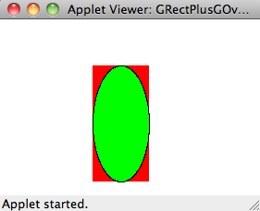
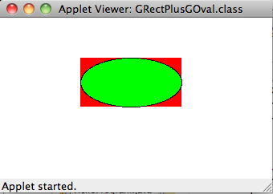
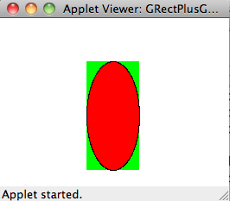
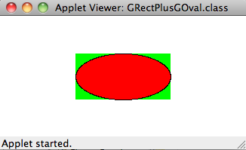
public class GRectPlusGOval extends GraphicsProgram {
public void run() {
GRect rect = new GRect(100, 50, 125, 60);
rect.setFilled(true);
rect.setColor(Color.RED);
add(rect);
GOval oval = new GOval(100, 50, 125, 60);
oval.setFilled(true);
oval.setFillColor(Color.GREEN);
add(oval);
}
}
C
D
A
B

Slide 27
The GRectPlusGOval Program
public class GRectPlusGOval extends GraphicsProgram {
public void run() {
GRect rect = new GRect(100, 50, 125, 60);
rect.setFilled(true);
rect.setColor(Color.RED);
add(rect);
GOval oval = new GOval(100, 50, 125, 60);
oval.setFilled(true);
oval.setFillColor(Color.GREEN);
add(oval);
}
}
public class GRectPlusGOval extends GraphicsProgram {
public void run() {
GRect rect = new GRect(100, 50, 125, 60);
rect.setFilled(true);
rect.setColor(Color.RED);
add(rect);
GOval oval = new GOval(100, 50, 125, 60);
oval.setFilled(true);
oval.setFillColor(Color.GREEN);
add(oval);
}
}
rect
rect
oval
oval
GRectPlusGOval
skip simulation

Slide 28

Exercise:
Drawing a Car
Write down a program that draws the following

Slide 29
Exercise:
Drawing a Car
import acm.graphics.*;
import acm.program.*;
public class HelloProgram extends GraphicsProgram {
public void run() {
// Write your code here
}
}

Slide 30
Exercise:
Drawing a Car
Inside the public void run() { ... }
GRect rectTop = new GRect(75, 45, 50, 15);
GRect rectBottom = new GRect(50, 60, 100, 20);
GOval wheelLeft = new GOval(65, 70, 20, 20);
wheelLeft.setFilled(true);
GOval wheelRight = new GOval(115, 70, 20, 20);
wheelRight.setFilled(true);
add(rectTop);
add(rectBottom);
add(wheelLeft);
add(wheelRight);

Slide 31
The End

